Slide 1
Introduction to Simulation

Slide 2
System : Process or facility is called system.
A system is defined to be a collection of entities, e.g., people or machines, that
act and interact together toward the accomplishment of some logical end.
"A group of objects that are joined together in some regular interaction or interdependence toward the accomplishment of some purpose" (Banks et al)
State : Collection of variables necessary to describe a system at a particular time
The state of a system is the variables (and their values) at one instance in time
System Components
Entities
Objects of interest within a system
Typically "active" in some way
Ex: Customers, Employees, Devices, Machines, etc
Contain attributes to store information about them
Ex: For Customer: items purchased, total bill
May perform activities while in the system
Ex: For Customer: shopping, paying bill

Slide 3
Category of System : Discrete and Continuous
A discrete system is one for which the state variables change instantaneously at separated points in time
Example1: A bank is an example of a discrete system , since state variables--e.g., the number of customers in the bank change only when a customer arrives or when a customer finishes being served and departs.
Example2: Number of students in MSIT When a registration or add is completed, number of students increases, and when a drop is completed, number of students decreases
A continuous system is one for which the state variables change continuously with respect to time.
Example1: An airplane moving through the air is an example of a continuous system, since state variables such as position and velocity can change continuously with respect to time
Example2: Volume of CO₂ in the atmosphere CO₂ is being generated via people (breathing), industries and natural events and is being consumed by plants

Slide 4
How to Study the System
Experiment with the Actual System vs . Experiment with a Model of the System:
If it is possible (and cost-effective) to alter the system physically and then let it operate under the new conditions, it is probably desirable to do so, for in this case there is no question about whether what we study is
System Model: A representation of the system to be used / studied in place of the actual system Allows us to study a system without actually building it. The assumptions that is used to study a system scientifically about how it works. These assumptions are called Models and can be in the form of mathematical or logical relationships
Physical Model vs. Mathematical Model :
Physical Model: A physical representation of the system (often scaled down) that is actually constructed
images of clay cars in wind tunnels, cockpits disconnected from their airplanes to be used in pilot training, miniature supertankers.
Most real-world systems are too complex to allow realistic models to be evaluated analytically

Slide 5
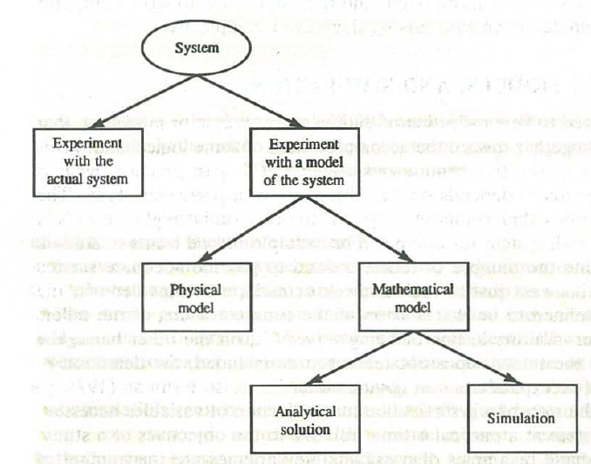
Mathematical Model: Representing the system using logical and mathematical
relationships
Algebra, Calculus, or probability theory
For Example: relation d = rt, where r is the rate of travel, t is the time
spent traveling, and d is the distance traveled.

Slide 6
Analytical Solution
After Building a mathematical model examined the model to answer the question
of interest about the system it is supposed represent analytical solution.
In the d = rt example, if we know the distance to be traveled and the velocity, then we can work with the model to get t = dlr
Many systems are highly complex, so that valid mathematical models of them are
themselves complex and possibility of an analytical solution is difficult.
In this case, the model must be studied by means of simulation, i.e. , numerically exercising the model for the inputs in question to see how they affect the output measures of performance
Simulation: using computers to imitate, or simulate, the system.

Slide 7
What is simulation?
Banks, et al:
"A simulation is the imitation of the operation of a real-world process or system over time". It "involves the generation of an artificial history of a system, and the observation of that artificial history to draw inferences … "
Law & Kelton:
"In a simulation we use a computer to evaluate a model (of a system) numerically, and data are gathered in order to estimate the desired true characteristics of the model”
More specifically (but still superficially)
We develop a model of some real-world system that (we hope) represents the essential characteristics of that system
Does not need to exactly represent the system – just the relevant parts
We use a program (usually) to test / analyze that model
Carefully choosing input and output
We use the results of the program to make some deductions about the real-world system

Slide 8
Why (or when) do we use simulation?
Consider arbitrary large system X
Could be a computer system, a highway, a factory, a space probe, etc.
We'd like to evaluate X under different conditions
Option 1: Build system X and generate the conditions, then examine the results
This is not always feasible for many reasons:
X may be difficult to build
X may be expensive to build
We may not want to build X unless it is "worthwhile"
The conditions that we are testing may be difficult or expensive to generate for the real system

Slide 9
Why (or when) do we use simulation?
For example:
A company needs to increase its production and needs to decide whether it should build a new plant or it should try to increase production in the plants it already has
Which option is more cost-effective for the company?
Clearly, building the new plant would be very expensive and would not be desirable to do unless it is the more cost-effective solution
But how can we know this unless we have built the new plant?
Another (ongoing) example:
NASA wants to know if damage on the Space Shuttle will threaten it upon re-entry
If they wait until re-entry to make a judgment, it is already too late
In this case it is not feasible to do the real-world test

Slide 10
Why (or when) do we use simulation?
Option 2: Model system X, simulate the conditions and use the simulation results to decide
Continuing with the same first example:
Model both possibilities for increasing production and simulate them both
We then choose the solution that is most economically feasible
Continuing with the Space Shuttle example
Model the damage and the stress that re-entry imparts on the shuttle
Determine via a simulation if the damage will threaten the shuttle or not

Slide 11
Application Areas of Simulation
Designing and analyzing manufacturing systems
Evaluating hardware and software requirements for a computer system
Evaluating a new military weapons system or tactic
Determining ordering policies for an inventory system
Designing communications systems and message protocols for them
Designing and operating transportation facilities such as freeways, airports, subways, or ports
Evaluating designs for service organizations such as hospitals, post offices, or fast -food restaurants
Analyzing financial or economic systems

Slide 12
STEPS IN A SIMULATION STUDY
Formulate problem and plan the study
Collect data and define a model

Slide 13
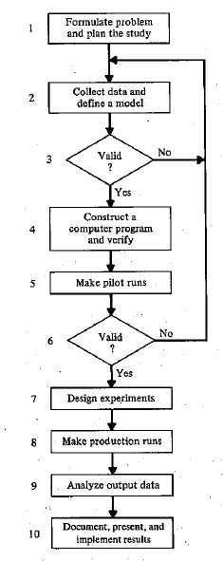

Slide 14
Issues in Simulation
Writing computer programs to execute them can be an difficult task.
simulation of complex systems is that a large amount of computer time is often required.
Simulation methodology is largely independent of the software and hardware required

Slide 15
Don't use a simulation if the system is too complex to model correctly / accurately
This is often not obvious
Can depend on cost and alternatives as well
However, a bad model may not be helpful and could actually be harmful
Ex: With the Space Shuttle, lives were at risk – if the model predicts incorrectly the results are catastrophic

Slide 16
When is simulation NOT a good idea?
Don't use a simulation when the problem can be solved in a "simpler" or more exact way
Some things that we think may have to be simulated can be solved analytically
Ex: Given N rolls of a fair pair of dice, what are the relative expected frequencies of each of the possible values {2, 3, 4, … 12} ?
We could certainly simulate this, "rolling" the dice N times and counting
However, based on the probability of each possible result, we can derive a more exact answer analytically

Slide 17
Don't use a simulation if it is easier or cheaper to experiment directly on a real system
Ex: A 24 hour supermarket manager wants to know how to best handle the cash register during the "midnight shift":
Have one cashier at all times
Have two cashiers at all times
Have one cashier at all times, and a second cashier available (but only working as cashier if the line gets too long)
Each of these can be done during operating hours
An extra employee can be used to keep track of queue data (and would not be too expensive)
Differences are (likely) not that drastic so that customers will be alienated

Slide 18
Type of Simulation Model
Static Model
Models a system at a single point in time, rather than over a period of time
Sometimes called Monte Carlo simulations
Dynamic Model
Models a system over time
Deterministic Model
Inputs to the simulation are known values
No random variables are used
Ex: Customer arrivals to a store are monitored over a period of days and the arrival times are used as input to the simulation
Stochastic Model
One or more random variables are used in the simulation
Results can only be interpreted as estimates (or educated guesses) of the true behavior of the system
Quality of the simulation depends heavily on the correctness of the random data distribution

Slide 19
Static vs. Dynamic Simulation Models: A static simulation model is a
representation of a system at a particular time, or one that may be used to
represent a system in which time simply plays no role; examples of static
On the other hand,
A dynamic simulation model represents a system as it evolves over time
Deterministic vs. Stochastic Simulation Models: If a simulation model does
not contain any probabilistic (i .e., random) components, it is called deterministic;
A complicated (and analytically intractable) system of differential equations
describing a chemical reaction might be such a model. In deterministic models,
the output is "determined" once the set of input quantities and relationships in the
model have been specified, even though it might take a lot of computer time to
evaluate what it is. Many systems, however, must be modeled as having at least
some random input components, and these give rise to stochastic simulation
models. simulation models produce output that is itself random, and must
Therefore be treated as only an estimate of the true characteristics of the model

Slide 20
Simulating a Single-Server Queue

Slide 21
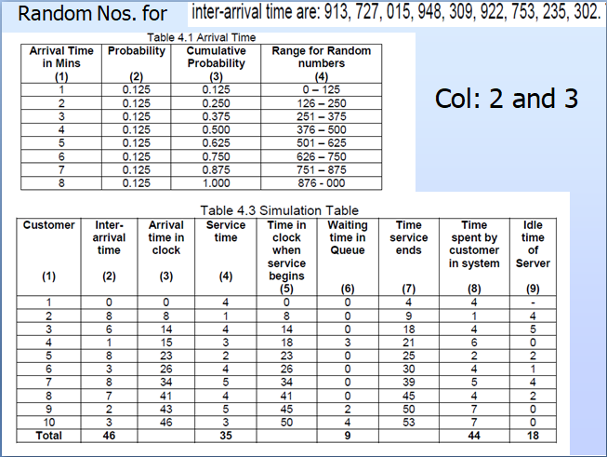

Slide 22
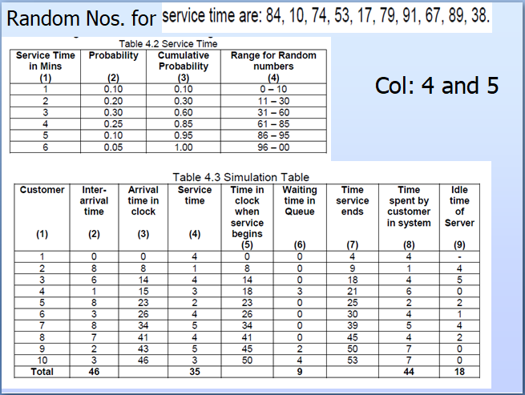

Slide 23
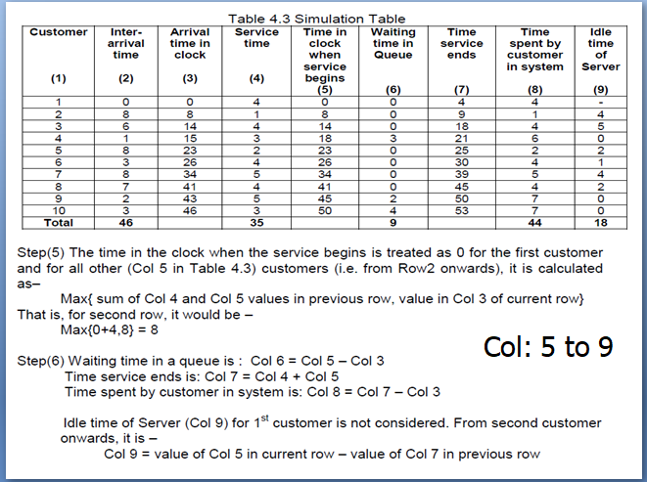

Slide 24
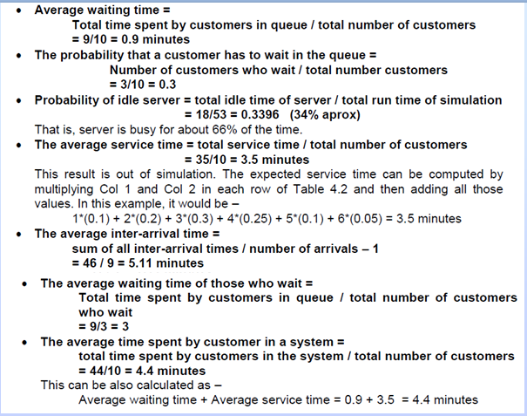

Slide 25
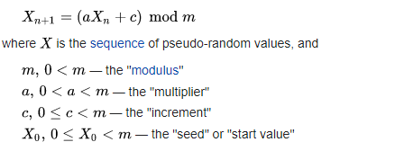
Random Sequence Generator using Linear congruential Method
This Method is defined by given Recurrence Relation

Slide 26
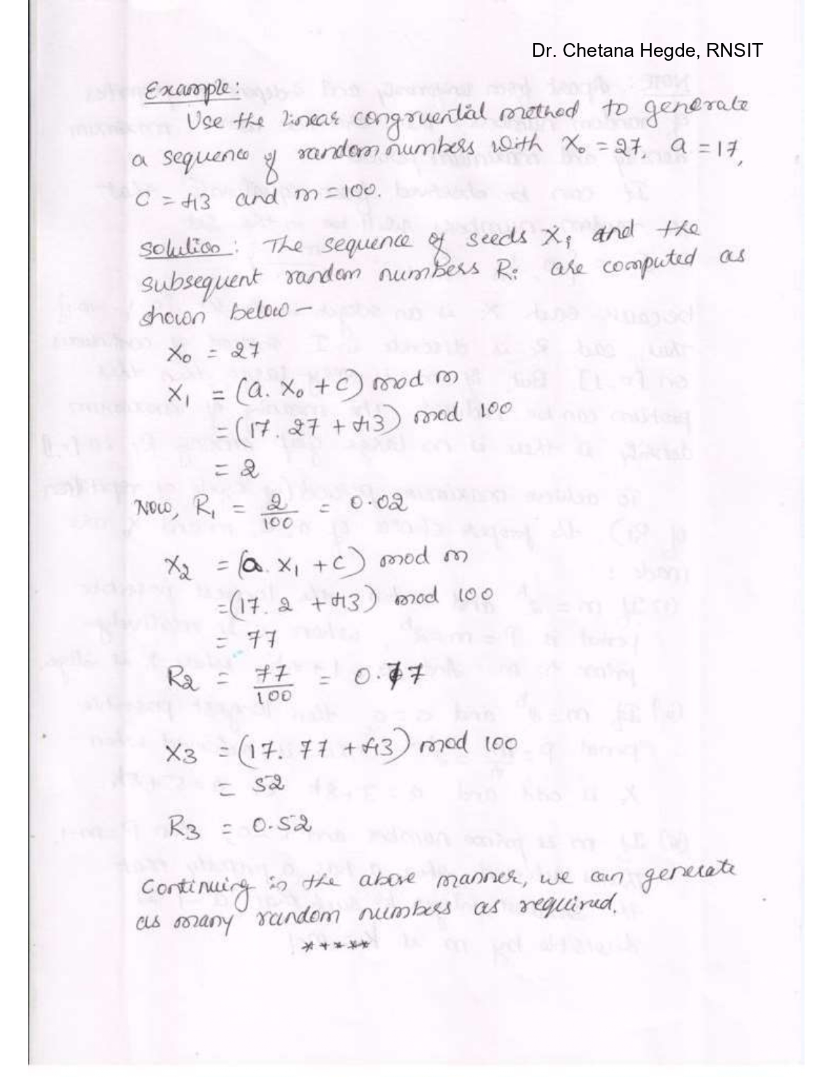
Random Sequence Generator using Linear congruential Method
X₀=27, a=17, c=43 and m=100

